Slide 1

Course Name: Mobile Application Development Credit Hours: 3(2,1) Instructor: Junaid Ali Khan

Slide 2
Course evaluation
4 Quizzes (15T)
4 Assignments (10T)
Mid term (25T)
Lab Tasks/Lab Assignments (25L)
Lab Mid term (25L)
1 Lab Project (50L)
Terminal Exam (50T)
Attendance (80%)

Slide 3
Course Description
Course Syllabus, CDF and CLO’s

Slide 4
Lecture 1

Slide 5

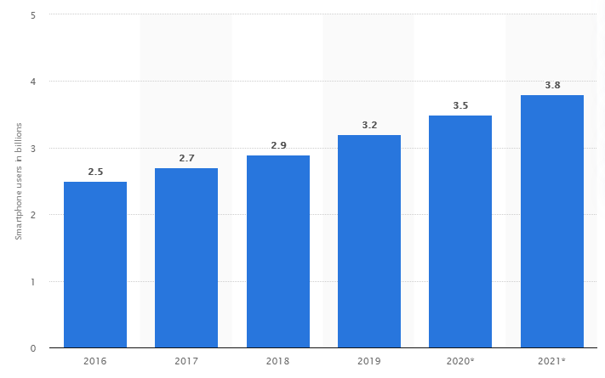

smartphone users worldwide from 2016 to 2022
Source: https://www.statista.com/

Slide 6
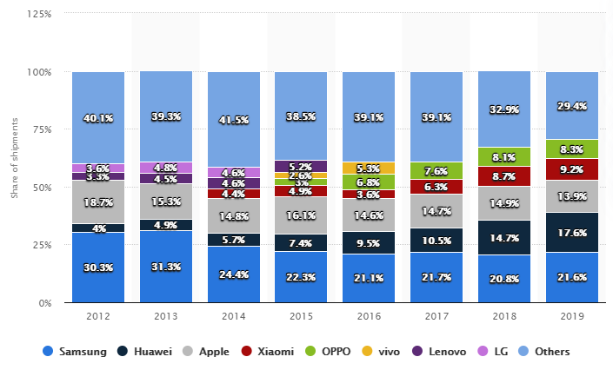
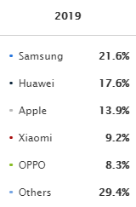
smartphone shipments worldwide from 2012 to 2021
Source: https://www.statista.com/

Slide 7


Mobile platforms
Google Android and Apple iOS have 98% of the global market share for operating systems
Android’s market share will reach 87% in 2022, forecasts suggest

Slide 8


Native mobile app development

Slide 9




Hybrid Mobile APP Development

Slide 10
Hot reloading, lets you see the changes you make in real-time.

Slide 11


About Course

